Slide 1
Artificial Intelligence
It is nothing but putting human Intelligence inside computer is AI.

Slide 2



Machine Learning is making machines to learn like humans.
Machine Learning have 3 types of learning
-Supervised learning
learning from someone
it has features and labels
It has regression and classification.

Slide 3
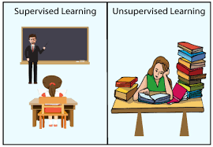
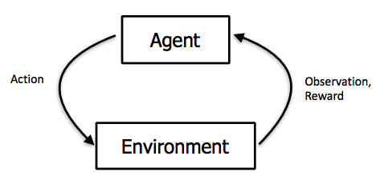
-Unsupervised Learning
Learning on own(self learning).
-Reinforcement Learning
Getting rewards and penalties

Slide 4
REGRESSION AND CLASSIFICATION
regression=1,2,3,4,5(continuous data prediction)
classification=(yes/no),(true/false),(male/female),(infected/defected)

Slide 5
Classification Algorithms
linear regression
logistic regression
decision tree
random forest
SVM(support vector machine)
KNN(k nearest neighbours)
Naive bayes

Slide 6
NUMPY : Number processing library in python is called NumPy.
SCIPY: Scientific number processing library in python.
Matplotlib: Representing the picture.
Pandas: It is used for Data Analysis.
Scikit Learn: It is machine learning library which contain the algorithm.
ERAS: It is deep learning/ machine learning library.

Slide 7
Features= input =x
Labels= y output
Model= y=2x(what u build from input and output)(equation)(function)(program)
x=1 y=3 , x=2 y=6 equation is y=3x
regular computer program= give input and get output
machine learning program= give input n output derive program

Slide 8
steps involved in ML programming
1. Get/Collect Data -(Kaggle)
x=1,3,5,7,8
y=2,6,10,14,16
2. Identify Algorithm -regression,classification
x 40 50 60 20 10
y 1 1 1 0
Building an mathematical equation btw input and output is ML or DL.

Slide 9
Every ml algorithm has 3 methods
Fit - build model by taking input and output
Predict -it will input and predict output depending on the equation we have built.
Score - used for prediction accuracy.

Slide 10
Linear Regression
Linear Regression is a machine learning algorithm based on supervised learning. It performs a regression task. Regression models a target prediction value based on independent variables. It is mostly used for finding out the relationship between variables and forecasting.

Slide 11
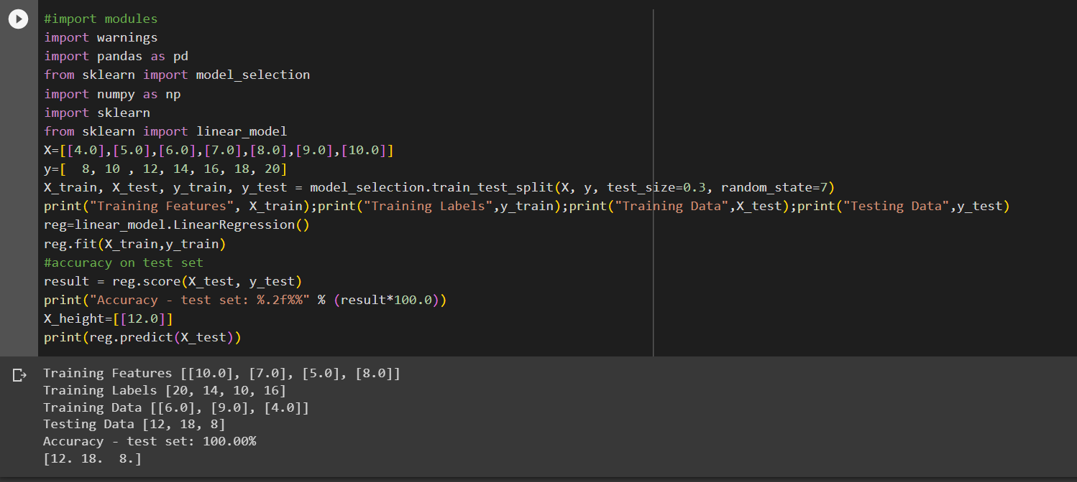

Slide 12
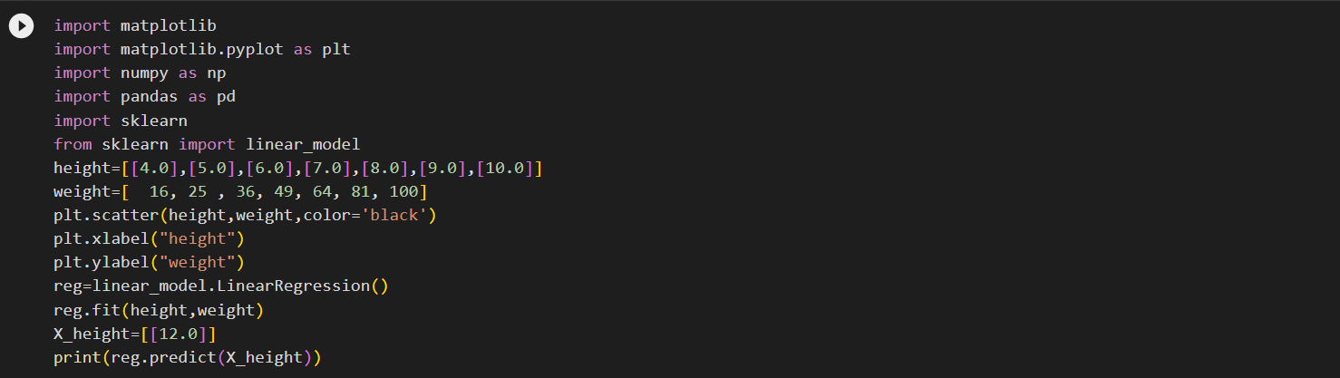
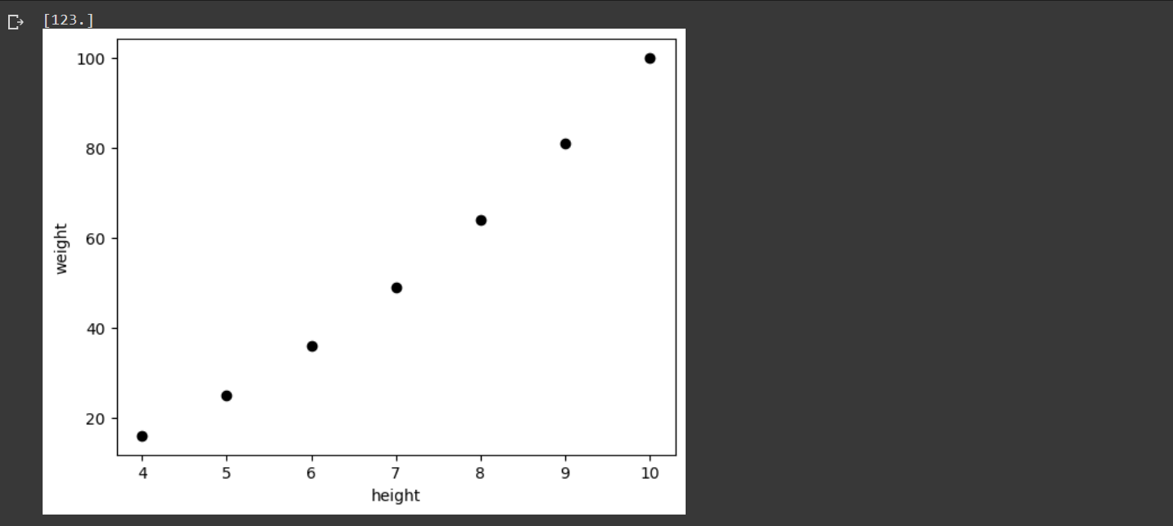

Slide 13
Naïve Bayes
Naive Bayes algorithm is a supervised learning algorithm, which is based on Bayes theorem and used for solving classification problems. It is not a single algorithm but a family of algorithms where all of them share a common principle, i.e. every pair of features being classified is independent of each other.

Slide 14
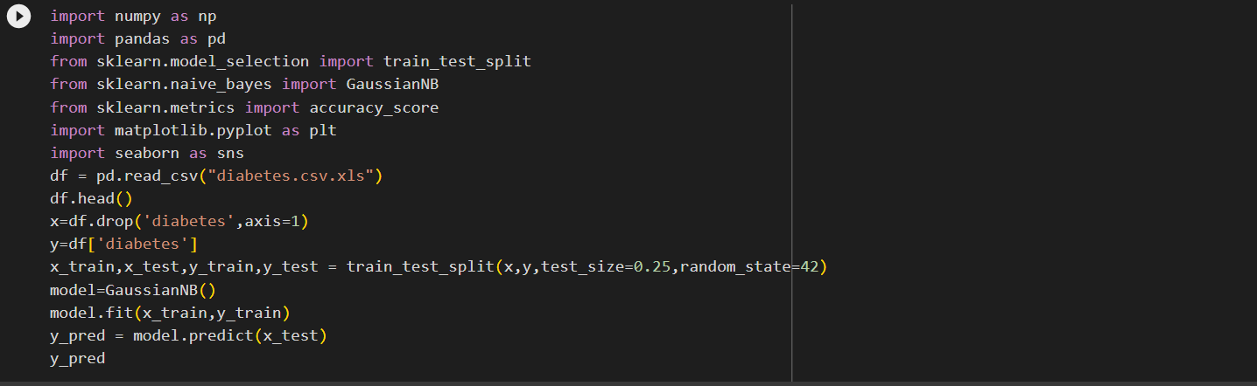
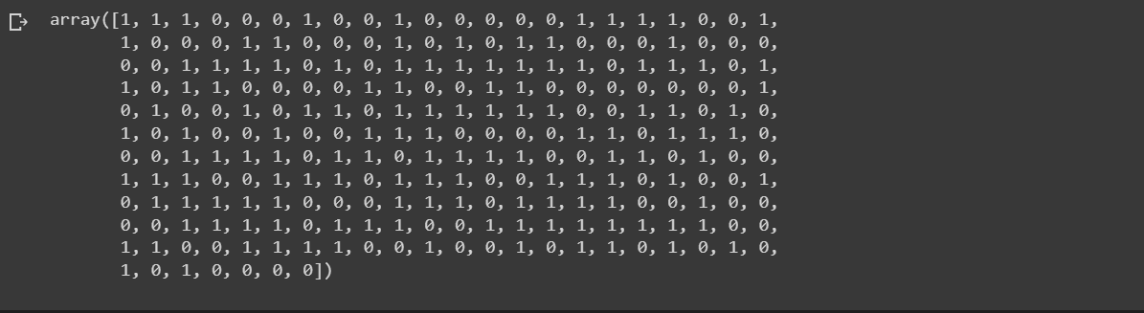
NAÏVE BAYES

Slide 15
Decision Tree
Decision Tree is a Supervised learning technique that can be used for both classification and Regression problems, but mostly it is preferred for solving Classification problems. It is a tree-structured classifier, where internal nodes represent the features of a dataset, branches represent the decision rules and each leaf node represents the outcome.
Support Vector Machine
Support Vector Machine(SVM) is a supervised machine learning algorithm used for both classification and regression. Though we say regression problems as well its best suited for classification. The objective of SVM algorithm is to find a hyperplane in an N-dimensional space that distinctly classifies the data points.

Slide 16
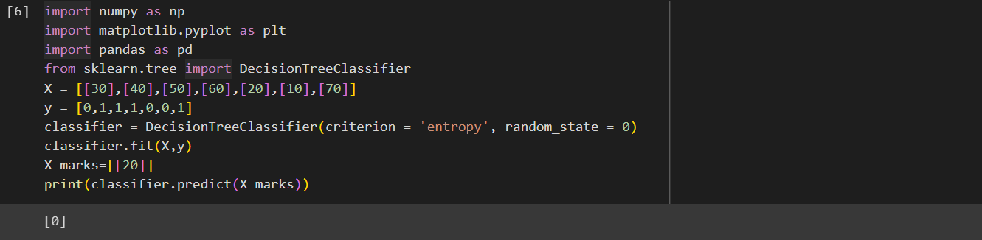
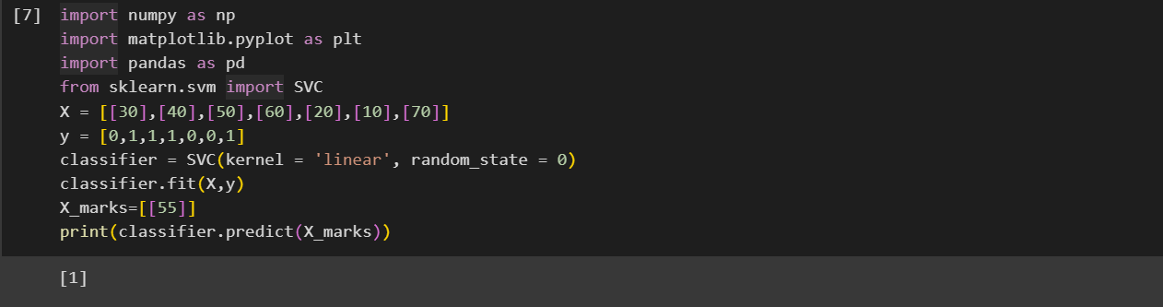
Decision Tree
Support Vector Machine

Slide 17
K – Nearest Neighbours
K-NN is one of the simplest Machine Learning algorithms based on Supervised Learning technique.
K-NN algorithm assumes the similarity between the new case/data and available cases and put the new case into the category that is most similar to the available categories.
Random Forest
Random forest is a Supervised Machine Learning Algorithm that is used widely in Classification and Regression problems. It builds decision trees on different samples and takes their majority vote for classification and average in case of regression.

Slide 18
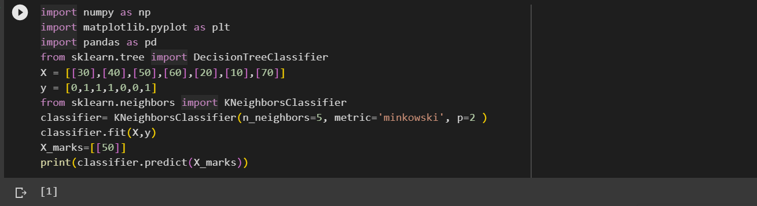
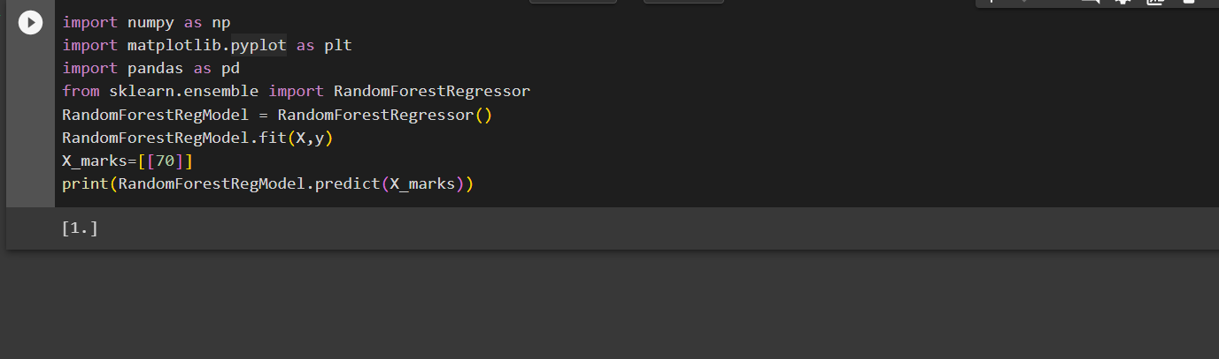
K- Nearest neighbours
Random Forest

Slide 19
THANK YOU

